Slide 1
NYC Motor Vehicle Collisions Analysis
Kelvin Nguyen
Data 101 - Section 9
9/25/2025
Source: NYC Open Data

Slide 2
About the Dataset
Source: NYC Open Data - Motor Vehicle Collisions -> Motor Vehicle Collisions - Crashes | NYC Open Data
Each row = one collision event
Covers all 5 boroughs of NYC
Contains hundreds of thousands of records (large dataset)
Time range: multiple years of collision data
Format: CSV file with an estimated 2 million rows

Slide 3
Key Attributes and Motivation
Important Columns:
Borough - location of collision
Number_of_persons_injured - injury count
Number_of_persons_killed - fatality count
Crash_date, Crash_time - when it happened
Why interesting:
Helps study traffic safety and risk patterns
Useful for urban planning and accident prevention
Allows us to explore patterns in collisions and identify factors that lead to injuries or fatalities in NYC

Slide 4
Summary Stats - Persons Injured
Mean: 0.33 persons
Median: 0 persons
Standard Deviation: 0.71
Interquartile Range (IQR): 0
Most crashes cause no injuries (median = 0, IQR = 0)
The mean is slightly higher than 0, meaning a few crashes with injuries raise the average
Most collisions result in no injuries, but some collisions involve many people, which raises the mean above the median

Slide 5
Summary Stats - Persons Killed
Mean: 0.0016 persons
Median: 0 persons
Standard Deviation: 0.042
Maximum: 8 persons
Almost all crashes cause zero fatalities (median = 0)
The maximum of 8 shows rare but severe accidents
Fatalities are rare, with the median at 0, indicating that most collisions are non-fatal

Slide 6
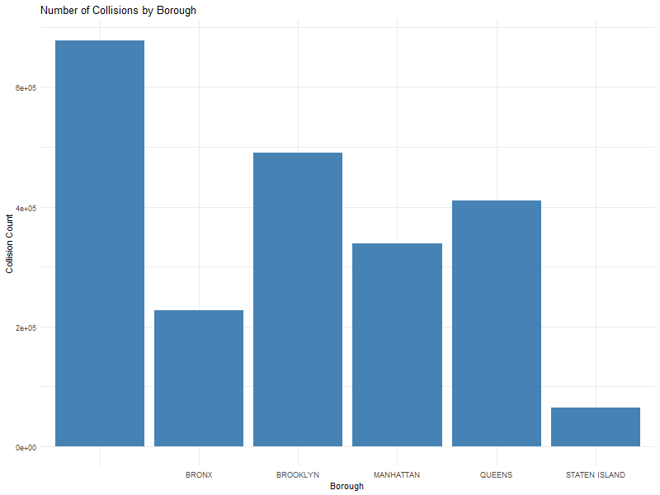
Collisions by Borough
Brooklyn and Queens show the highest number of collisions
Staten Island has the fewest collisions
Distribution reflects borough population and traffic density
Brooklyn has the highest number of collisions, while Staten Island has the fewest

Slide 7
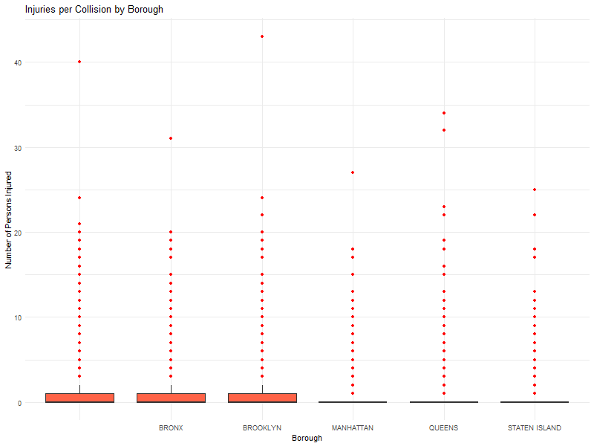
Distribution of Injuries by Borough
Most collisions result in 0 injuries (median = 0)
Some boroughs (for example Brooklyn, Queens) show rare but high-injury crashes
Data has outliers, which explains why mean > median in summary stats

Slide 8
Key Findings
Most crashes result in no injuries or fatalities
A few extreme accidents raise the accidents (skewed data)
Brooklyn and Queens have the most collisions overall
Severe injury/fatal crashes are rare, but impactful

Slide 9
Why this Data Matters
Road safety is a public health and policy issue
Data helps identify high-risk boroughs and areas
Insights can guide traffic law enforcement and safety campaigns

Slide 10
Limitations
Some rows have missing borough data
Dataset may include reporting errors
Does not directly show causes (driver behavior, weather, etc.)
Very large dataset makes calculations slower without filtering

Slide 11
Future Analysis
Filter by year for more focused insights
Compare time of day or day of week patterns
Explore vehicle types involved in severe crashes
Use predictive models to identify risk factors

Slide 12
Conclusion
Data shows crashes are common but rarely fatal
Larger boroughs = more collisions, but not always more severe
Analysis provides insight for policy makes and drivers
Shows the value of data analysis in real world safety issues

